Slide 1
AGENDA
What is deep linking?
Deep linking in App
Custom URI Scheme vs App Links
Deep linking vs Deferred deep linking

Slide 2
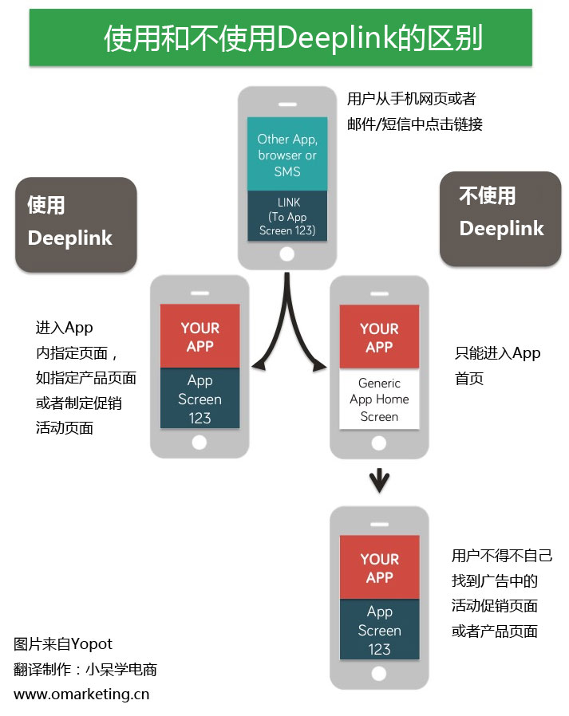
What is deep linking?
In the context of mobile, deep linking describes the action of delivering users to specific in-app content from wherever they are.

Slide 3
Deep linking in App
iOS
Android
URL Scheme
Universe Link (iOS 9)
URL Scheme
App Links (android 6)

Slide 4
Custom URL Scheme
App Links
dyson://dl:88/lobby?name=tom&age=12
https://auth.cp.dyson.com/callback/alexa/prod/link
<activity android:name=".SecondActivity" android:exported="true"> <intent-filter> <action android:name="android.intent.action.CUSTOM" /> <category android:name="android.intent.category.DEFAULT" /> <data android:host="dl" android:path="/lobby" android:port="88" android:scheme="dyson" /> </intent-filter> </activity>
<activity android:name=".ThirdActivity" android:exported="true"> <intent-filter android:autoVerify="true"> <action android:name="android.intent.action.VIEW" /> <category android:name="android.intent.category.DEFAULT" /> <category android:name="android.intent.category.BROWSABLE" /> <data android:scheme="https" android:host="auth.cp.dyson.com" android:pathPrefix="/callback/alexa/prod/link" /> </intent-filter> </activity>

Slide 5
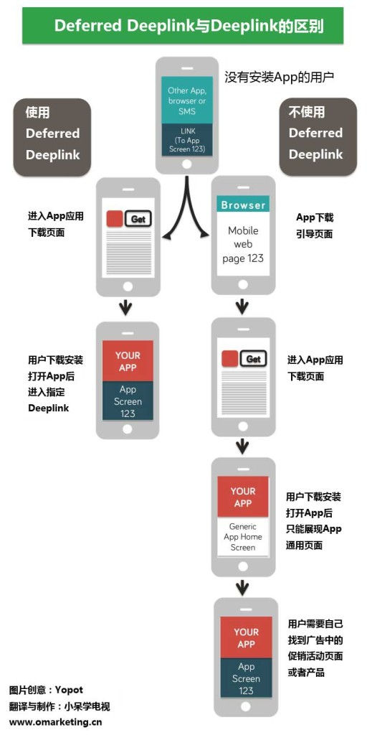
Deep linking
vs
Deferred deep linking

Slide 6
Deep Linking

